Slide 1
[NAME OF STUDENT]
[Student]
Portfolio
[DATE CREATED]
[NAME OF PRIMARY SCHOOL]

Slide 2
What I’ve accomplished
[NAME OF STUDENT]
(Motivation) Good morning, everyone. My name is [Your Name], and today I'm excited to present my amazing project I've developed using Pygame. The motivation behind this project was to create an interactive and educational game that introduces children to different types of vehicles while testing their ability to identify them.
(Define Problem) My problem statement is to design a game that challenges kids to quickly recognize and name various vehicles. The aim is to combine entertainment with educational elements to enhance children's knowledge and responsiveness.
(Ideate Approach) To address this challenge, I ideated a concept where vibrant images of vehicles would appear randomly on the screen. The players' task is to identify each vehicle promptly, fostering rapid cognitive processing and visual recognition. Adding an element of excitement, the game includes a scoring system that rewards accuracy and speed.
(Create Solution) Leveraging the Pygame library, I implemented the solution, incorporating a dynamic spawning mechanism for vehicle images and an interactive user interface. Correct identifications earn points, and a timer adds a sense of urgency to the game. Players progress to the next level by identifying a specific number of vehicles within the given time or achieving a high score. The game also features a defined game over condition to provide feedback and encourage replayability. The result is a functional and visually appealing game that aligns with the initial goal of providing an enjoyable learning experience for children.
2
Notes:
Poppins Light – 18 size

Slide 3
[NAME OF STUDENT]
Process Flow
Create an interactive game to test kids' reactions in identifying vehicles.
Define Problem
Develop a concept where various vehicles appear on the screen, and the player needs to select the correct one promptly. Leverage Pygame for graphical elements and user input handling.
Ideate Approach
Using Pygame, the solution comprises a main game loop with randomized vehicle appearances. Players gain points for correctly identifying vehicles within a time constraint. Introduce different levels with increasing complexity by adding more diverse vehicles.
Create
Solution
3
Notes:
Poppins Light – 18 size

Slide 4
[NAME OF STUDENT]
State Flow
Scoreboard
This flowchart shows how the transition between the different states. For instance, after seeing the scoreboard, players can choose to start their game and it will naturally move from ready to question to answer for the player to write an answer. Results will be shown immediately. A final winner screen will show who won the game.
Ready
Gameplay
Result
Winner
4
Notes:
Poppins Light – 18 size

Slide 5
[NAME OF STUDENT]
Python Concept
Pygame is a set of Python modules designed for writing video games. It provides functionality for creating windows, handling events like key presses, and drawing graphics on the screen.
Pygame
Random library provides functions for generating random numbers. This can be useful for scenarios where randomness is required, such as selecting questions or shuffling elements in a game.
Random
Time.sleep() function causes the program to pause for a specified number of seconds. It's commonly used to introduce delays in code execution, which can be useful in scenarios like creating countdowns or simulating time-based events.
Time.Sleep
5
Notes:
Poppins Light – 18 size

Slide 6
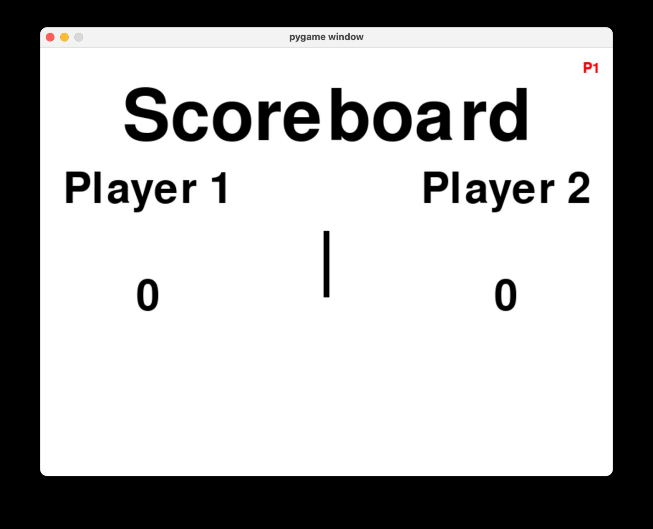
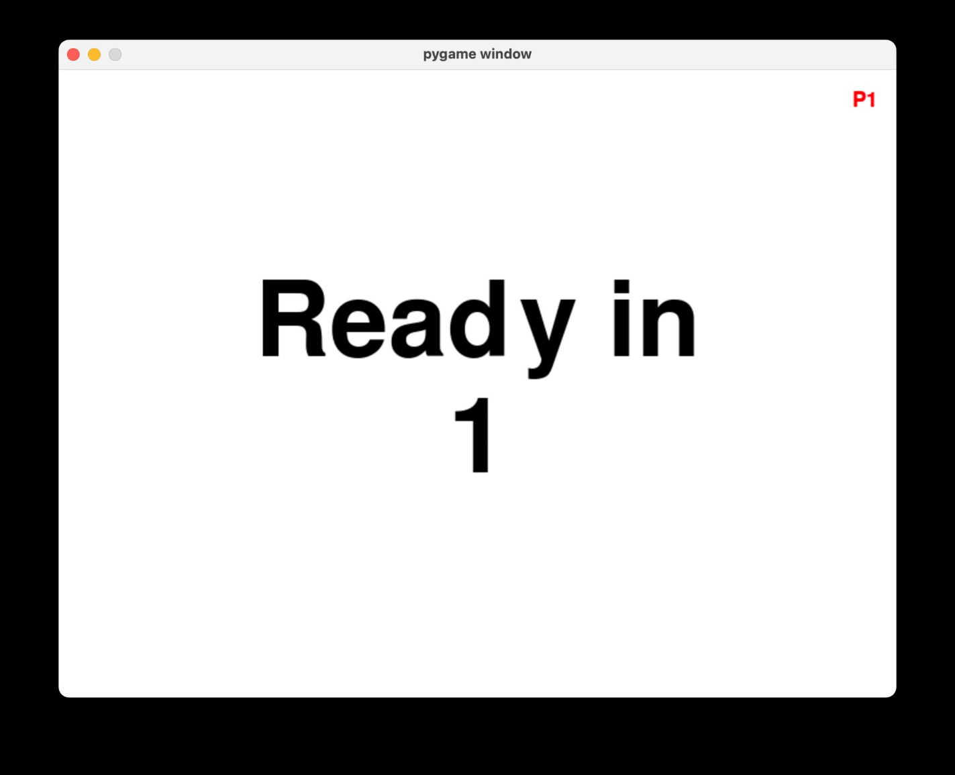
[NAME OF STUDENT]
Mock Screens
Ready In
1
Description
Description
Scoreboard Screen
Ready Screen
6
Notes:
Poppins Light – 18 size

Slide 7
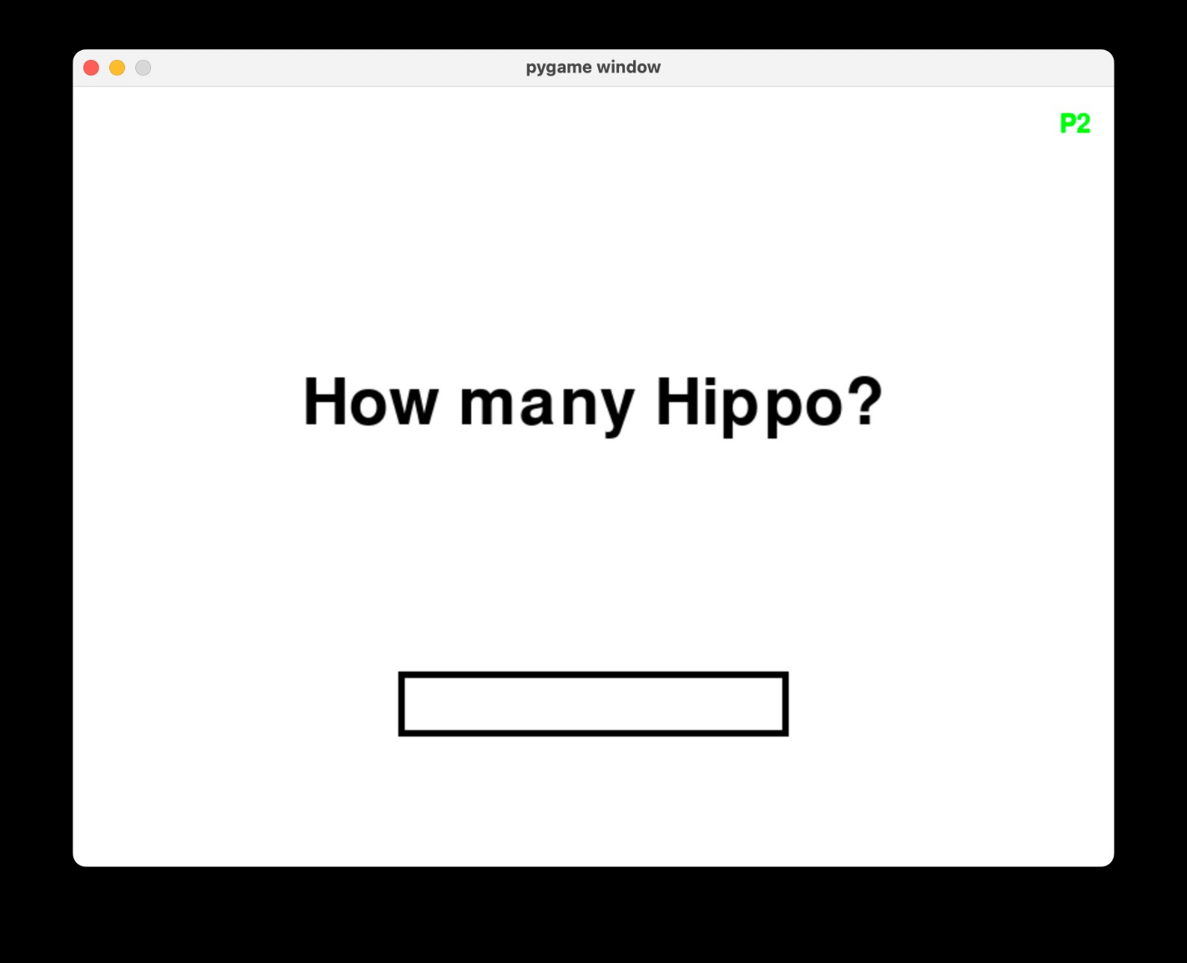
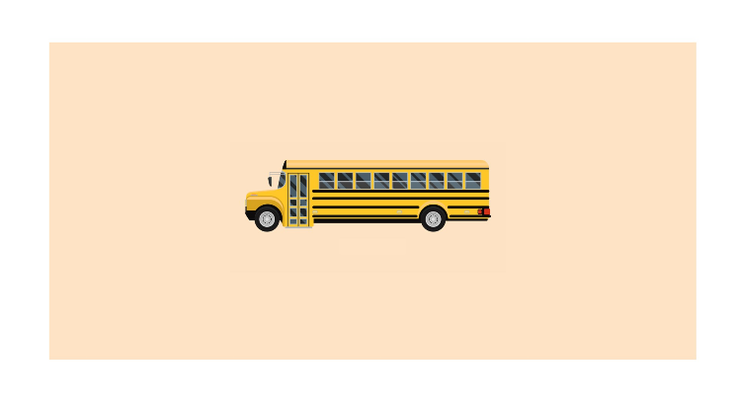
[NAME OF STUDENT]
Mock Screens
Score: 0
Time: 100
Is this a bus?
Description
Gameplay Screen
7
Notes:
Poppins Light – 18 size

Slide 8
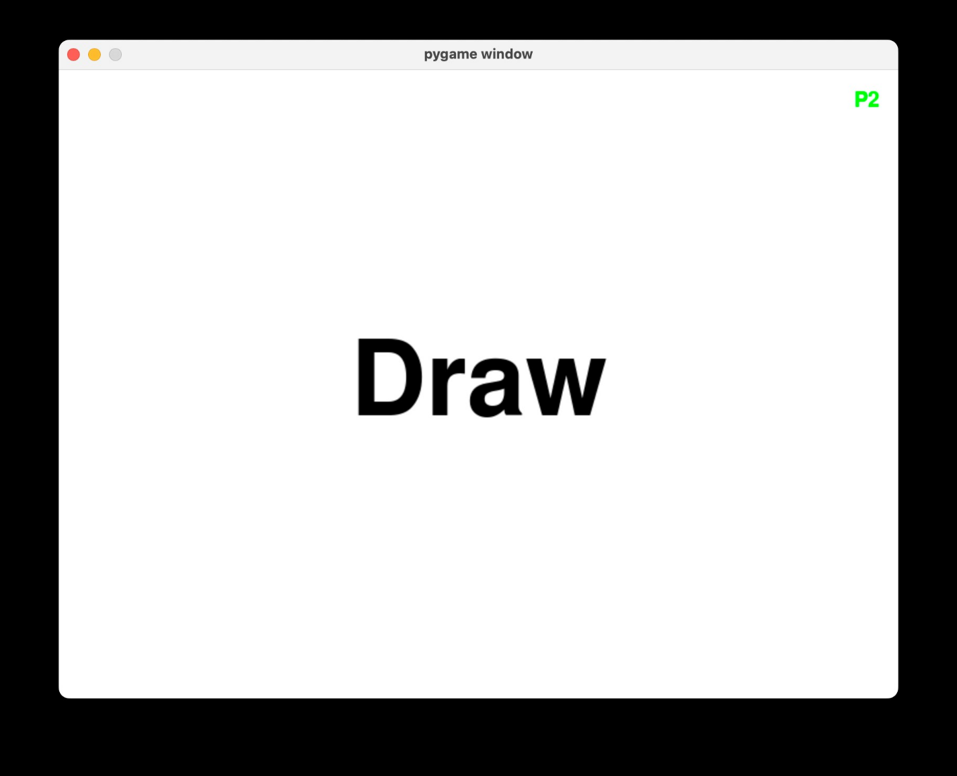
[NAME OF STUDENT]
Mock Screens
You scored 1
Player 1
Wins!
Description
Description
Result Screen
Winner Screen
8
Notes:
Poppins Light – 18 size

Slide 9
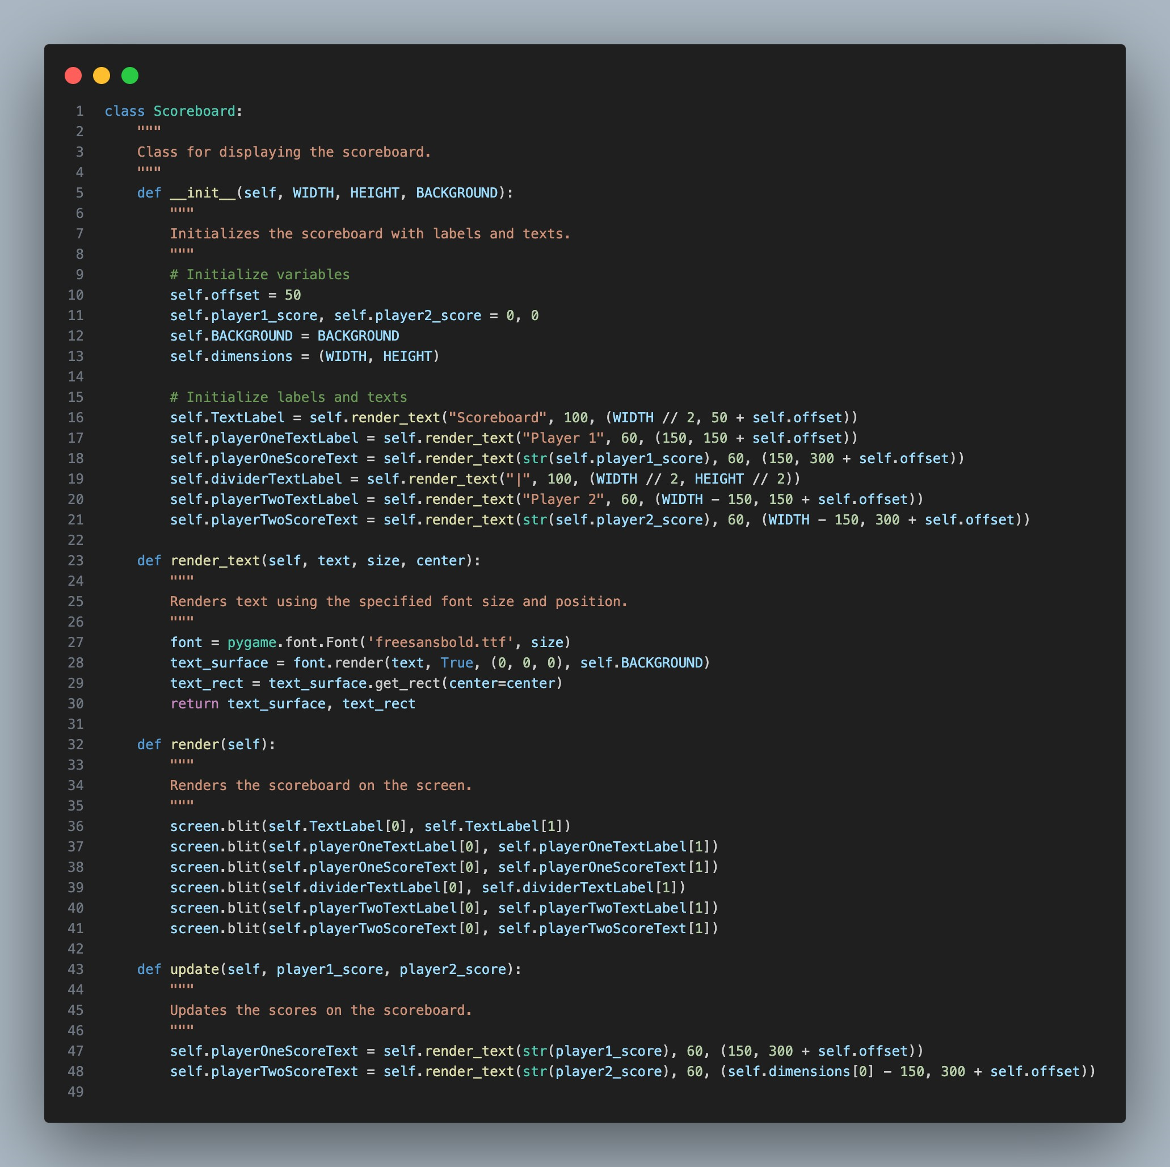
Scoreboard Screen
Displays player scores and labels.
Provides an overview of the current game state.
Elements include player names and their respective scores.
9
Scoreboard Screen
Notes:
Poppins Light – 18 size

Slide 10
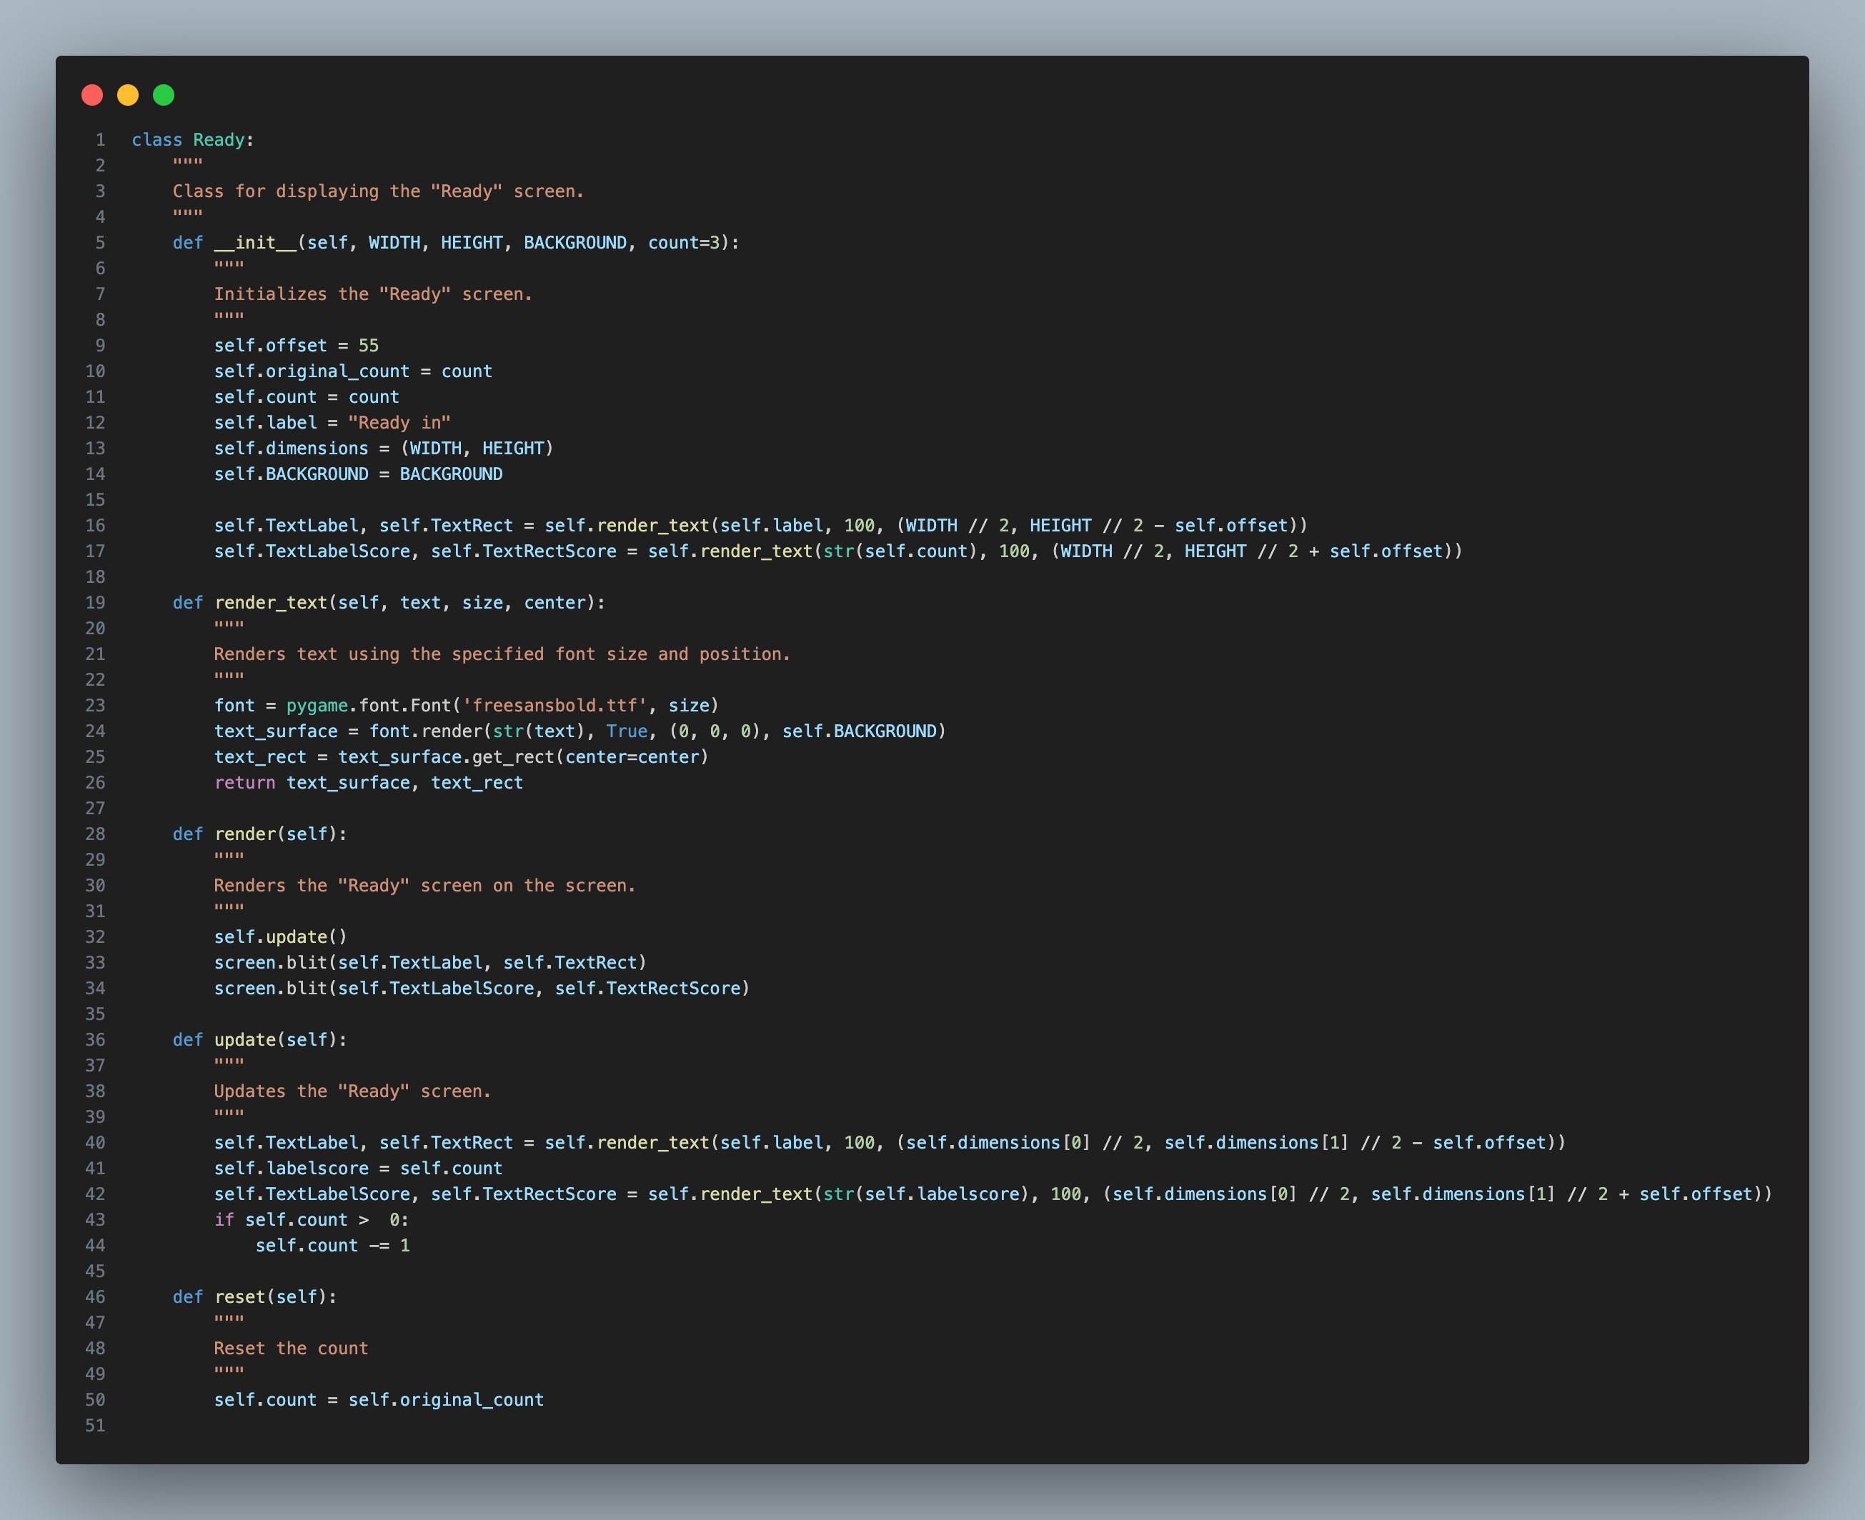
Ready Screen
Counts down to the start of the quiz.
Presents the label "Ready in" and the countdown timer.
Prepares players for the upcoming question.
Ready In
1
10
Ready Screen
Notes:
Poppins Light – 18 size

Slide 11
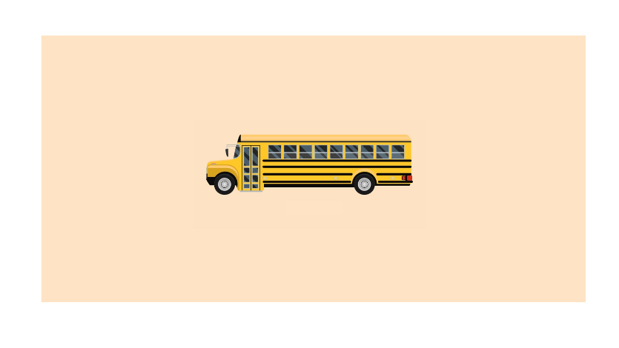
Y`
Gameplay
If Time Left > 0?
No
0
Loads the next question for every correct response
If wrong answer is given or time runs out, end gameplay.
Yes
No
Is Answer Given?
Yes
Is Answer Correct?
No
Yes
Increase Score by 1
Load next Question
Result Screen
11
Gameplay Screen
Notes:
Poppins Light – 18 size

Slide 12
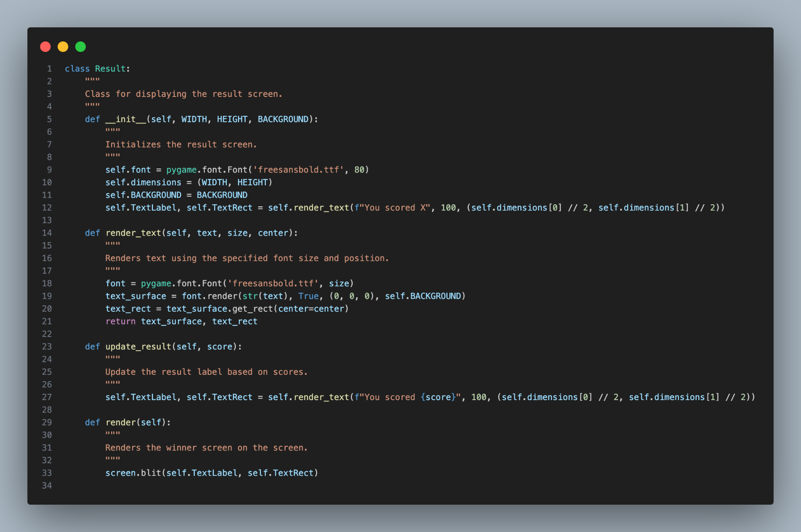
Result Screen
Shows the outcome of the player's answer.
Indicates whether the answer was correct or not.
Presents the label "You scored" and the score.
You scored 1
13
Result Screen
Notes:
Poppins Light – 18 size

Slide 13
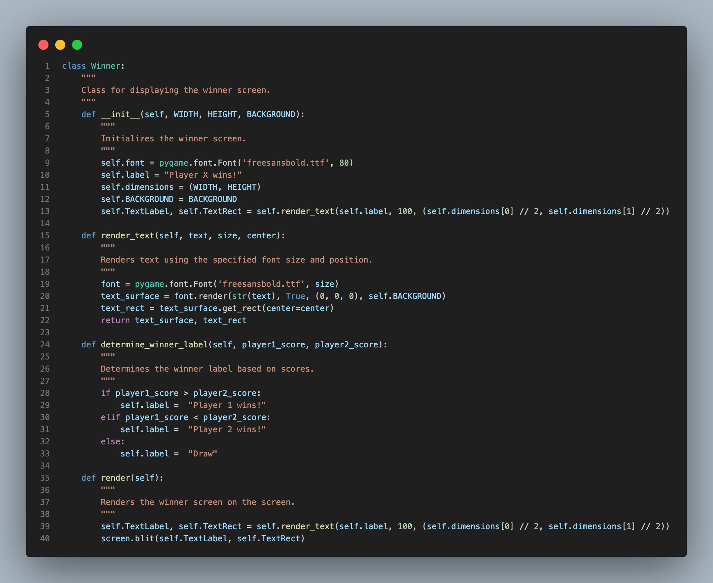
Winner Screen
Declares the winner of the game.
Displays the label "Winner" along with the winning player or a draw message.
Celebrates the victor of the quiz.
Player 1
Wins!
14
Winner Screen
Notes:
Poppins Light – 18 size

